Slide 1
Crimmigration Law
César Cuauhtémoc García Hernández, University of Denver Sturm College of Law
Carlos Moctezuma García, García & García Attorneys at Law, PLLC
Javier N. Maldonado, Law Offices of Javier N. Maldonado
AILA Texas Chapter Spring 2014 Conference
April 25, 2014

Slide 2
Disclaimer
CrImmigration changes everyday and with every smart attorney making a creative argument
What we say today might change tomorrow
For updates, visit crImmigration.com

Slide 3
Overview of This Talk
Categorical & Modified Categorical Approach: Key Supreme Court and Fifth Circuit Cases – César
Practical Approach for a Non-Citizen Client: Texas Burglary of Habitation – Carlos
Challenging The Current Interpretation: Texas Assault – Javier

Slide 4
Categorical approach
What is it? Method of determining if criminal offense falls into a category of crime listed in INA
Key cases
Taylor v. United States, 495 U.S. 575 (1990)
Shepard v. United States, 544 U.S. 13 (2005)
Matter of Silva-Treviño, 24 I&N Dec. 687 (A.G. 2008)
Silva-Treviño v. Holder, 742 F.3d 197 (5th Cir. 2014)
Developments in the U.S. Supreme Court in 2012-13 Term
Moncrieffe v. Holder, 133 S. Ct. 1678 (2013)
Descamps v. United States, 133 S. Ct. 2276 (2013)
Notes:
Cesar takes over

Slide 5
Court’s methodology
Three Steps
What is the federal immigration category?
What conduct is required under the state statute of conviction?
If divisible, use modified categorical approach
Modified categorical approach allows consideration of record of conviction (charging document, plea agreement, plea hearing colloquy, judgment, judicial confession, jury instructions)
Is there a match?

Slide 6
Why restrict what immigration judges can consider?
Constitutional basis
Leave to the jury what the Sixth Amendment assigns to the jury
Statutory basis
Respect Congress’s desire to use conviction as basis of removal
Prudential concern
Avoid mini-trials in immigration court

Slide 7
A Practical Approach
Client is arrested for Burglary of a Habitation. He is married to a very successful and well-respected USC. Together they have several USC children. Client became an LPR in 2006. What to do?

Slide 8
Think About Immigration Case NOW!
Immigration status
LPR/B1/B2/EWI
Length of time in USA
USC/LPR family members
Category of crime
Aggravated felony
CIMT
Punishment
History
Criminal
Immigration
Notes:
Legal Status - Already determined that Javier is an LPR
Length of Time – this is important because we need to know when he became an LPR and what family members will help him in case he needs to go to immigration court
Category of Crime – a cursory review – which is never good (look at Descamps) – would tell us that this is an Aggravated Felony if convicted of anything other than Deferred Adjudication? And, there’s pretty good reason to believe that a burglary offense is a CIMT. 101(a)(43)(G) (“burglary offense for which the term of imprisonment is at least one year”)
Punishment – Burglary of a Habitation in Texas is a 2nd degree felony with a range of punishment between 2-20 years. Tex. Penal Code § 30.02; 12.33
History - how many times has he been arrested? What crimes? Were they CIMT’s?

Slide 9
The Facts in this Particular Case
Immigration status
LPR
Length of time in USA
Adjusted Status in 2006*
EWI and adjusted via 245(i)
Category of crime
Aggravated Felony and/or CIMT
Theft offense type of aggravated felony – INA 101(a)(43)(G); term of imprisionment at least 1 year
Crime of violence type of aggravated felony – United States v. Guardado, 40 F.3d 102, 103-04 (5th Cir. 1994)
Punishment range
2-20 years imprisonment
History
DWI in 2009
Notes:
This is what we found out after our first meeting after he got out on bond. He hadn’t been indicted and we had a sit down at my office.
Why is there an asterisk? Because this is what we found out after our first meeting.
**** Let’s take a look at his indictment *****

Slide 10
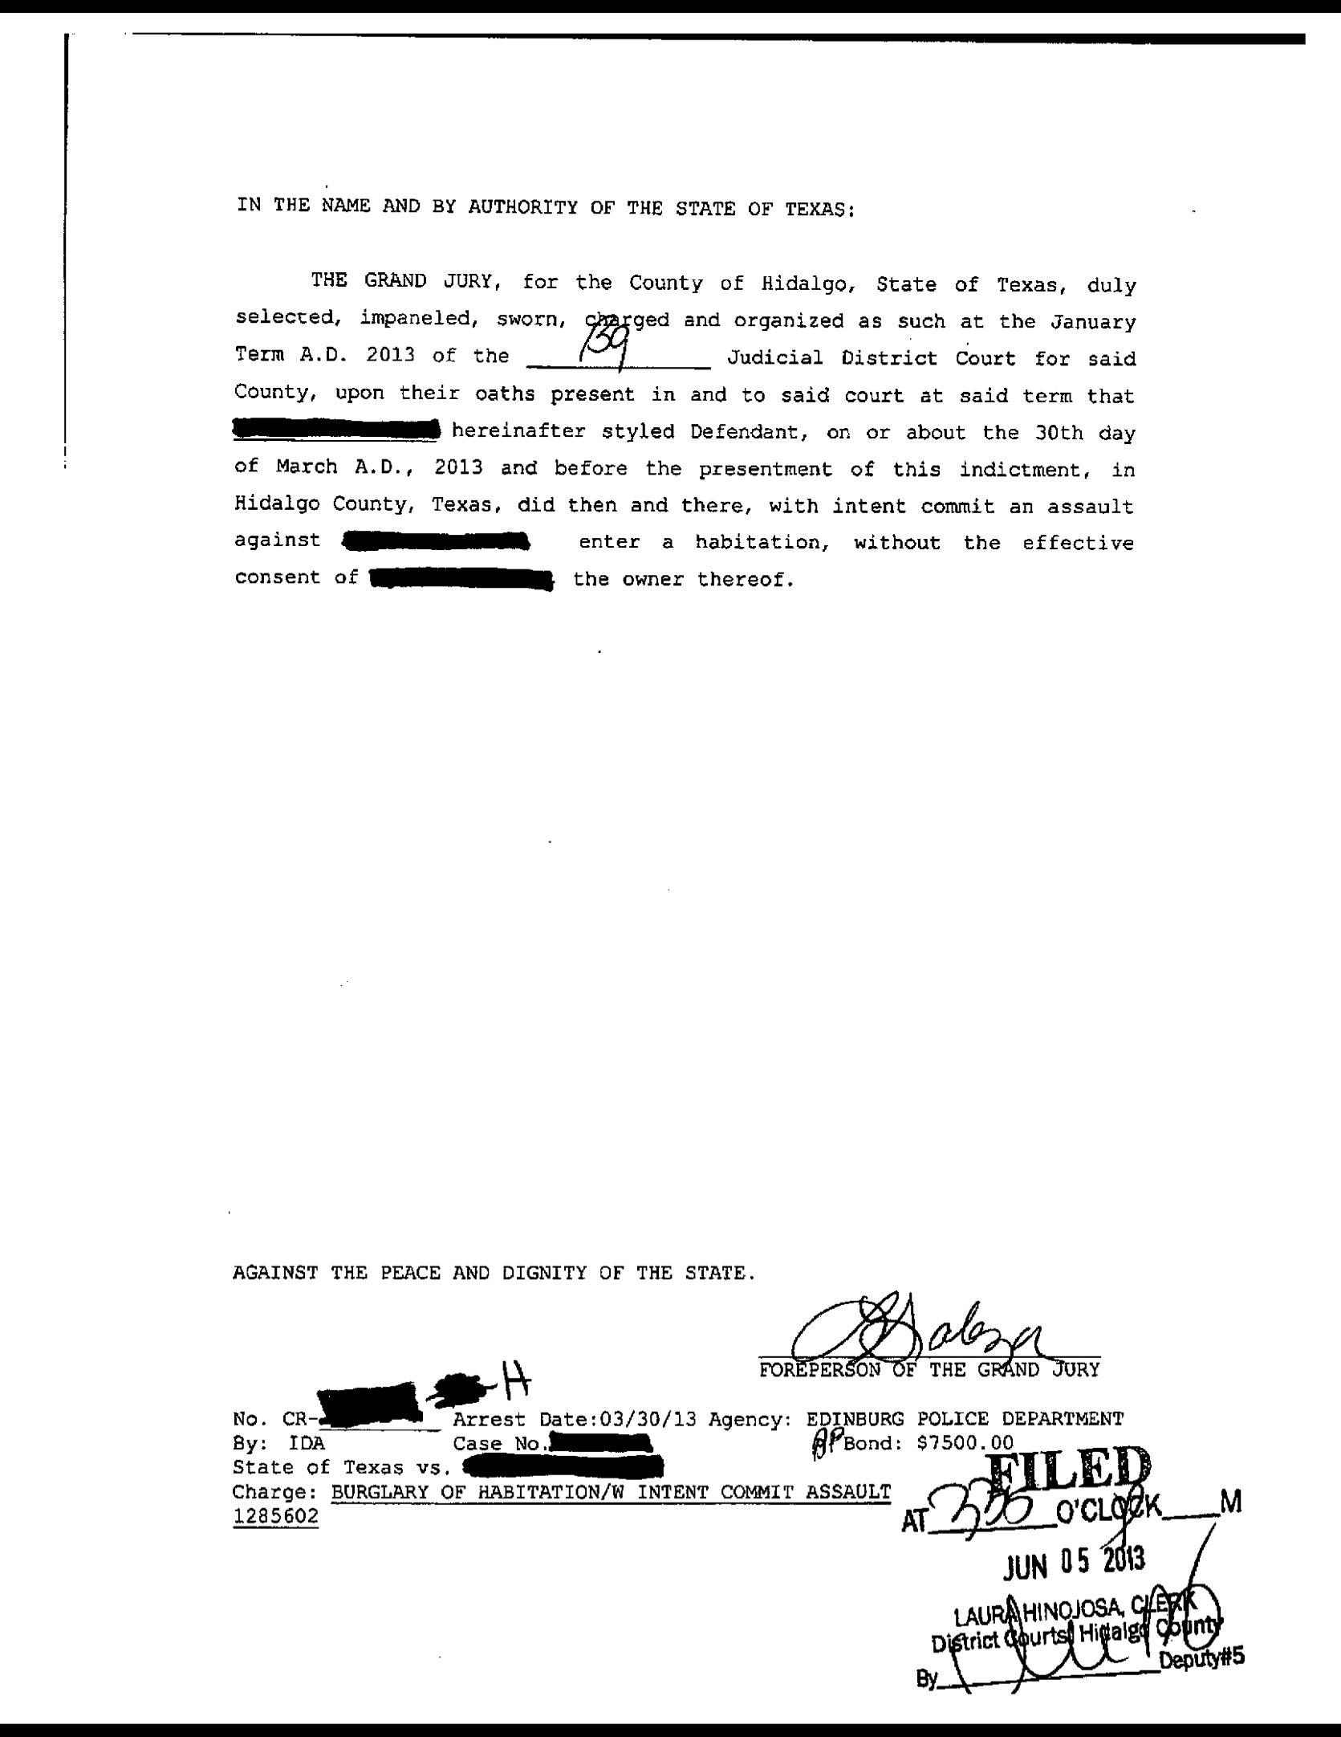
Indictment
Read it carefully
Notes:
I’ll just read it for everybody. Also, so everybody can see. Let’s put it up on the screen.

Slide 11
Criminal Case – Immigration Relief
Immigration relief
Cancellation of Removal – INA § 240A(a)
Ineligible if it’s an aggravated felony
(Re) Adjustment of Status – INA § 245(a)
Maybe with a waiver for CIMTs – INA § 212(h)
Remember: aggravated felonies aren’t grounds for inadmissibility
Asylum
1 year bar (withholding of removal)

Slide 12
The Criminal Case
He CAN’T plead guilty to Burglary of a Habitation
Is this a true statement?
101(a)(43)(G) requires a term of imprisonment
Deferred Adjudication is not imprisonment – INA 101(a)(48)(B)
But deferred adjudication is a conviction – Matter of Punu, 22 I&N Dec. 224 (BIA 1998); Moosa v. INS, 171 F.3d 994, 1006 (5th Cir. 1999)
Notes:
Is this a true statement? Let’s see if people were listening? Deferred Adjudication is a conviction BUT NOT a term of imprisonment.
SHOW - Offense Report to Negotiate with the State.

Slide 13
CrImmigration 101: Negotiating
Let’s look at the offense report – time to negotiate with the State

Slide 14
Negotiating with the State
Jail Time
Absolutely NOT
Deferred Adjudication
No term of imprisonment
Removability v. Inadmissibility
Not Removable – does not have two CIMT’s
INA 237(a)(2)(A)(ii)
LPR since 2006* so not within the 5 years for a CIMT
INA 237(a)(2)(A)(i)
Probably Inadmissible because crime is a CIMT
212(a)(2)(A)(ii) – petty offense exception does not apply
Notes:
Jail Time v. Deferred Adjudication: State hemming and hawing about Jail Time. This guy beat up a mentally challenged man.
Removability v. Inadmissiblity:
Inadmissible because petty offense exception does not apply because the maximum possible term of imprisonment for this felony exceeds 1 year

Slide 15
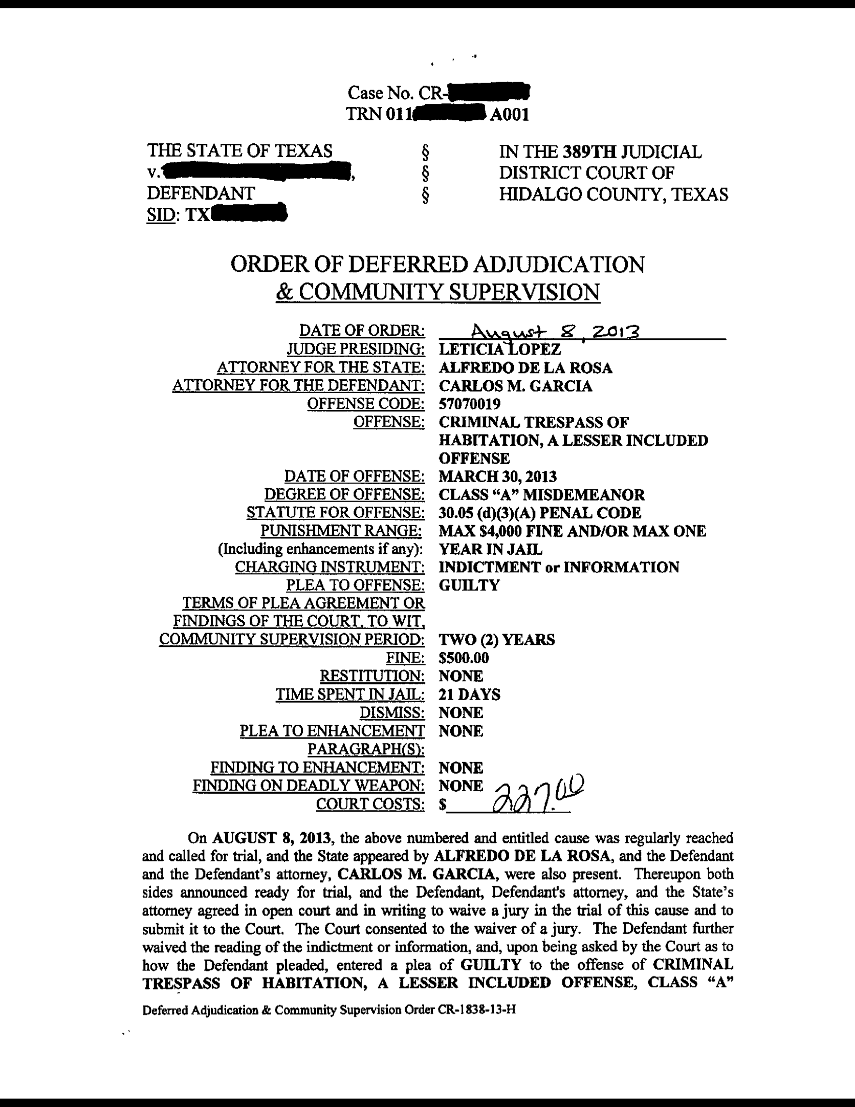
Regroup and Negotiate Again
Misdemeanor Assault
Stipulate to reckless
The End Result
Notes:
We got them to agree to stipulate to the reckless element of misdemeanor assault.
The End Result (show them the judgment of conviction – criminal trespass)

Slide 16
Texas Simple Assault Statute
Tex. Penal Code §22.01. ASSAULT.
(a) A person commits an offense if the person:
(1) intentionally, knowingly, or recklessly causes bodily injury to another, including the person's spouse;
(2) intentionally or knowingly threatens another with imminent bodily injury, including the person's spouse; or
(3) intentionally or knowingly causes physical contact with another when the person knows or should reasonably believe that the other will regard the contact as offensive or provocative.

Slide 17
Categorical Approach at Play
Descamps v. United States: cannot apply modified categorical approach and look to record of conviction when statute of convictions has a single, indivisible set of elements
Moncrieffe v. Holder: re-affirms strict categorical approach where the facts of the offense do not matter; rather do the elements of the state offense categorically fit within the generic federal offense; must presume that the state conviction rests on minimum conduct criminalized by statute
Silva-Treviño v. Holder: categorical approach applies to determination whether prior offense is a CMT; cannot consider extrinsic evidence

Slide 18
Texas Court of Criminal Appeals
Landrian v. State, 268 S.W.3d 532 (Tex.Crim.App. 2008).
Analyzes aggravated assault statute which incorporates simple assault
Holds that simple assault under Tex. Penal Code § 22.01(a)(1)-(3) sets forth 3 different offenses
Assault under § 22.01(a)(1) is a results-oriented offense: all that is required to obtain a conviction is that (1) a defendant, (2) with requisite culpability (either intentional, knowingly or reckless where jury unanimity is not required on the specific level of culpability), (3) causes, (4) bodily injury, (5) to another.

Slide 19
Assault Not Divisible – One Offense
That is notwithstanding the three levels of culpability in Tex. Penal Code § 22.01(a)(1), a conviction under § 22.01(a)(1) is a single offense
The different levels of culpability are “conceptually equivalent” and describe one offense
It follows from Descamps that the mens rea element in § 22.01(a)(1) is indivisible and a conviction under § 22.01(a)(1) requires a mens rea that is anything from intentional to reckless
The precise act or nature of the conduct does not matter. That is, whether the bodily injury was caused by pushing, punching, stabbing, or shooting. Landrian, 268 S.W.3d at 537.

Slide 20
Family Violence Argument
“What matters is that the conduct (whatever it may be) is done with the required culpability to effect the result the Legislature has specified.” Id.
Even when committed against a family member, a conviction for assault under Tex. Penal Code § 22.01(a)(1) is not a conviction for family violence or domestic violence.
The element of “another” or the victim in Tex. Penal Code § 22.01(a)(1) is broad: any person.
“That a victim is the spouse of the defendant or a member of the defendant’s household has no bearing on whether a defendant actually committed an assault and is not an essential element of assault.” Killebrew v. State, 2005 Tex.App. LEXIS 6204 (Tex.App.—Dallas 2005, pet dism’d).

Slide 21
Indictment Irrelevant
Descamps: it doesn’t matter that it was alleged that the victim was the spouse, that the defendant admitted the victim was his spouse, or that the court found the victim was the defendant’s spouse.
Silva-Trevino: the reviewing court cannot look at the indictment to determine how the injury was caused or whether the victim was someone other than the spouse.

